Slide 1
UPoint Registration Process 2018 Field Counselor Training Module

Slide 2
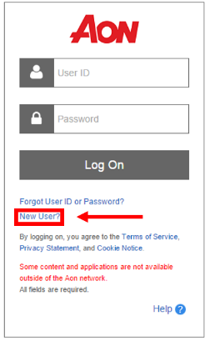
Accessing Aon UPoint
Go to http://resources.hewitt.com/aon
Select the New User? Option

Slide 3
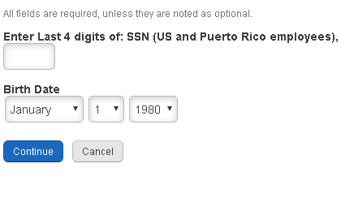
Accessing Aon UPoint
Follow the on-screen steps pictured below to register as a new user
If you have previously registered you will return to the login page and enter your username and password. If you need assistance resetting your password or do not remember your username, please utilize the “Forgot User ID or Password” option on the login page or contact the Aon HR Service Center at 1-855-625-5500.

Slide 4
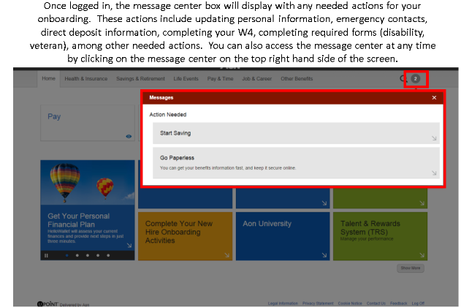
UPoint Inbox
Once you are logged in you will want to click on the UPoint Inbox Message Center icon located in the top right corner as pictured below. There will be a list of action items (around 6) you need to complete. A few of these items include filling out tax withholdings and direct deposit information.

Slide 5
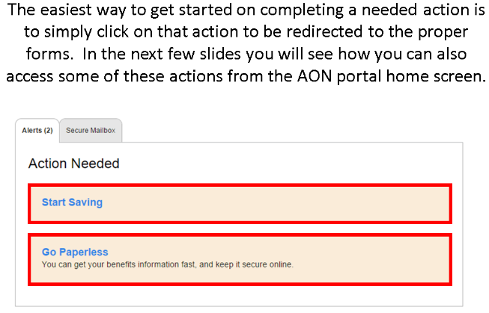
UPoint Actions

Slide 6
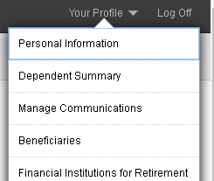
Updating Personal Information
Select “Your Profile” from the upper right corner and click “Personal Information” from the drop-down menu. **Be Sure to update and
verify your contact information and personal details!

Slide 7
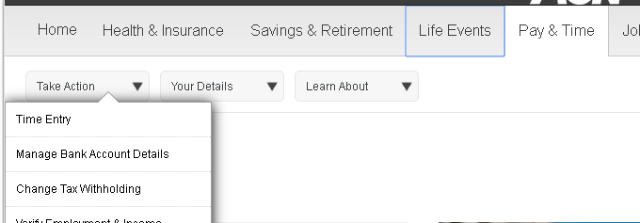
Updating/Verifying Direct Deposit Information
Select the “Pay & Time” tab and then choose “Take Action” followed by “Manage Bank Account Details”

Slide 8
Completing Tax Forms
Select the “Pay & Time” tab and then choose “Take Action” followed by “Change Tax Withholding”
**If you do not update/elect your tax withholding preferences you will automatically default to 0. This means the maximum allowable amount will be withheld from your check for taxes.

Slide 9
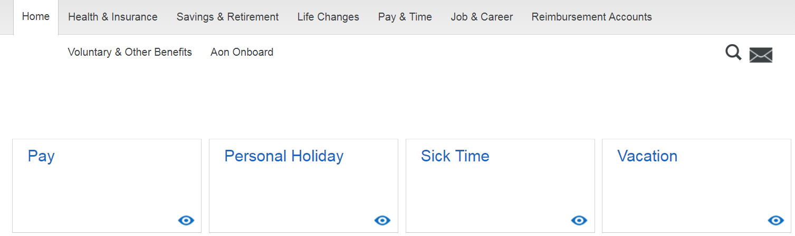
Accessing Workday
The fastest/easiest way to access workday is through UPoint. On the UPoint home screen you will select the “Pay” icon.

Slide 10
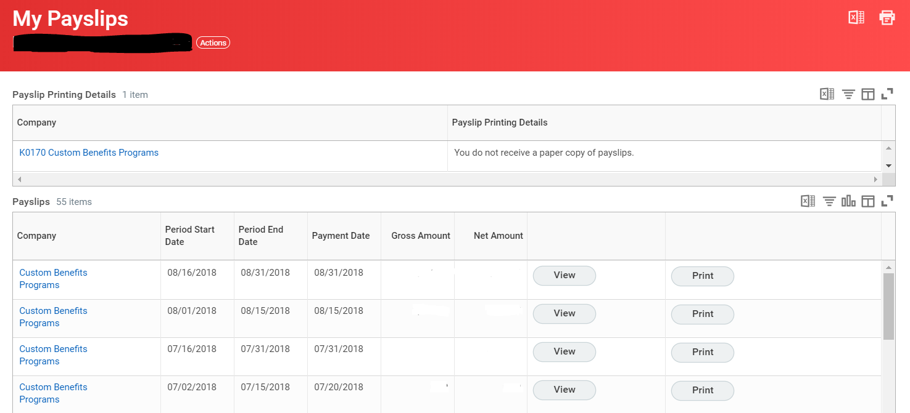
Accessing Workday
After selecting “Pay” on UPoint, you will be directed to the “My Payslips” page of WorkDay.

Slide 11
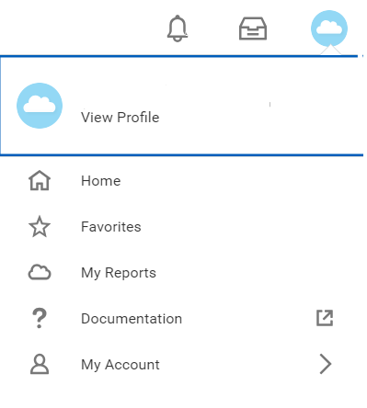
Accessing Workday
To access the Workday “Home” screen you will select the “cloud icon” in the top right of the screen and then select “Home”

Slide 12
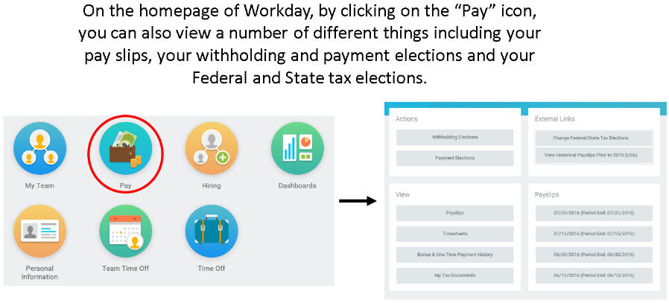
Workday Navigation
By clicking the “Pay” icon located on the Workday Homepage, you can also view a number of different items including your pay slips, tax withholding elections, and payment elections.

Slide 13
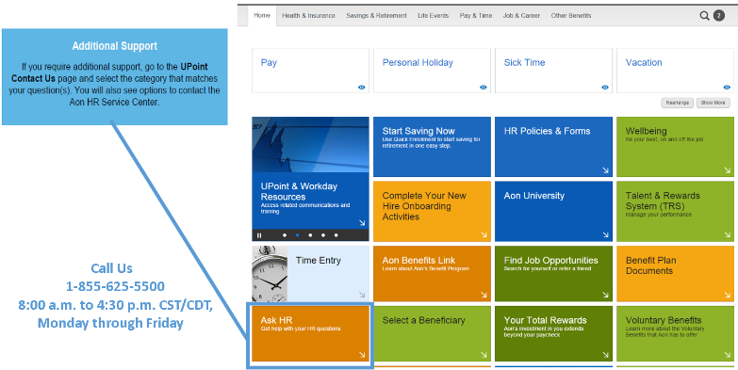
Aon Service Center

Slide 14
Thank you for your time! If you should have any questions concerning UPoint or Workday that this presentation did not address, please see your Enrollment Manager or contact the Aon HR Service Center at 1-855-625-5500.

